Slide 1

Comprehensive Machine Learning Pipeline for Breast Cancer Diagnosis
By
Bernard Djoko

Slide 2
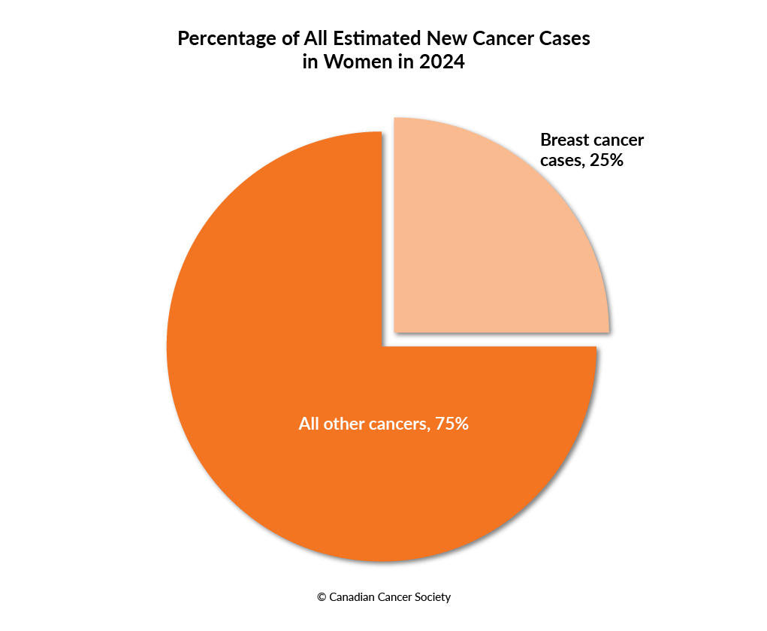
Why Breast Cancer Prediction Matters
Our goal is to explore how machine learning can support clinicians in making better, faster decisions."

Slide 3
Learning Objectives
Understand the stages of an ML pipeline
Explore feature engineering and SMOTE
Compare model performance
Interpret visualizations (e.g., confusion matrix, decision boundaries)

Slide 4
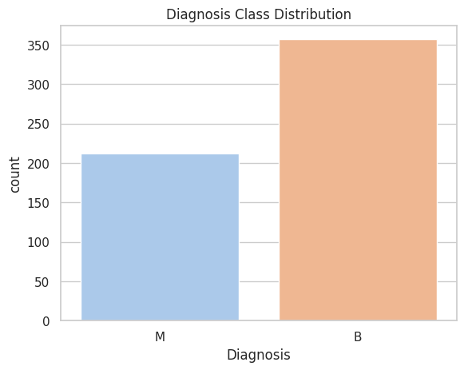
Data Preparation & Feature Engineering
[Figure 1: Diagnosis Class Distribution]

Slide 5
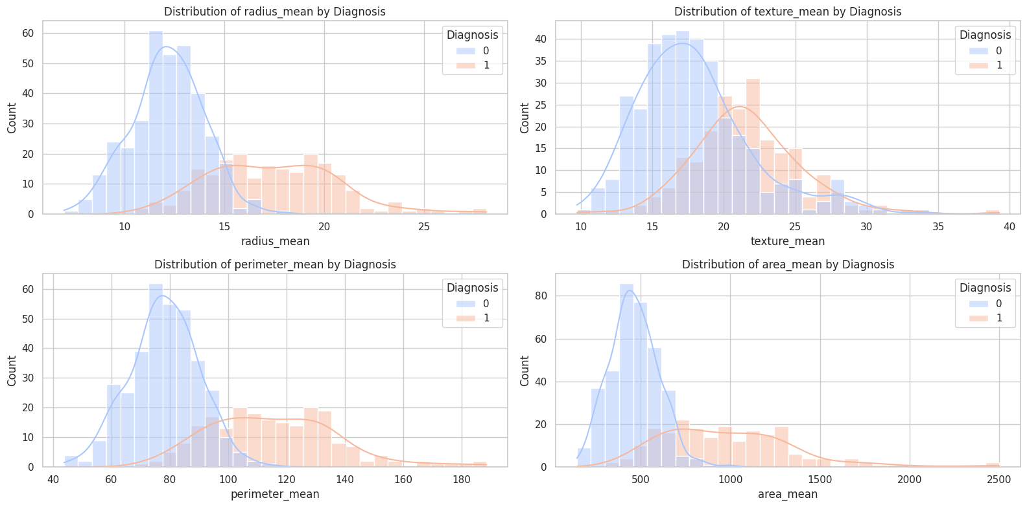
Data Preparation & Feature Engineering
[Figure 2: Feature Distributions by Diagnosis]

Slide 6
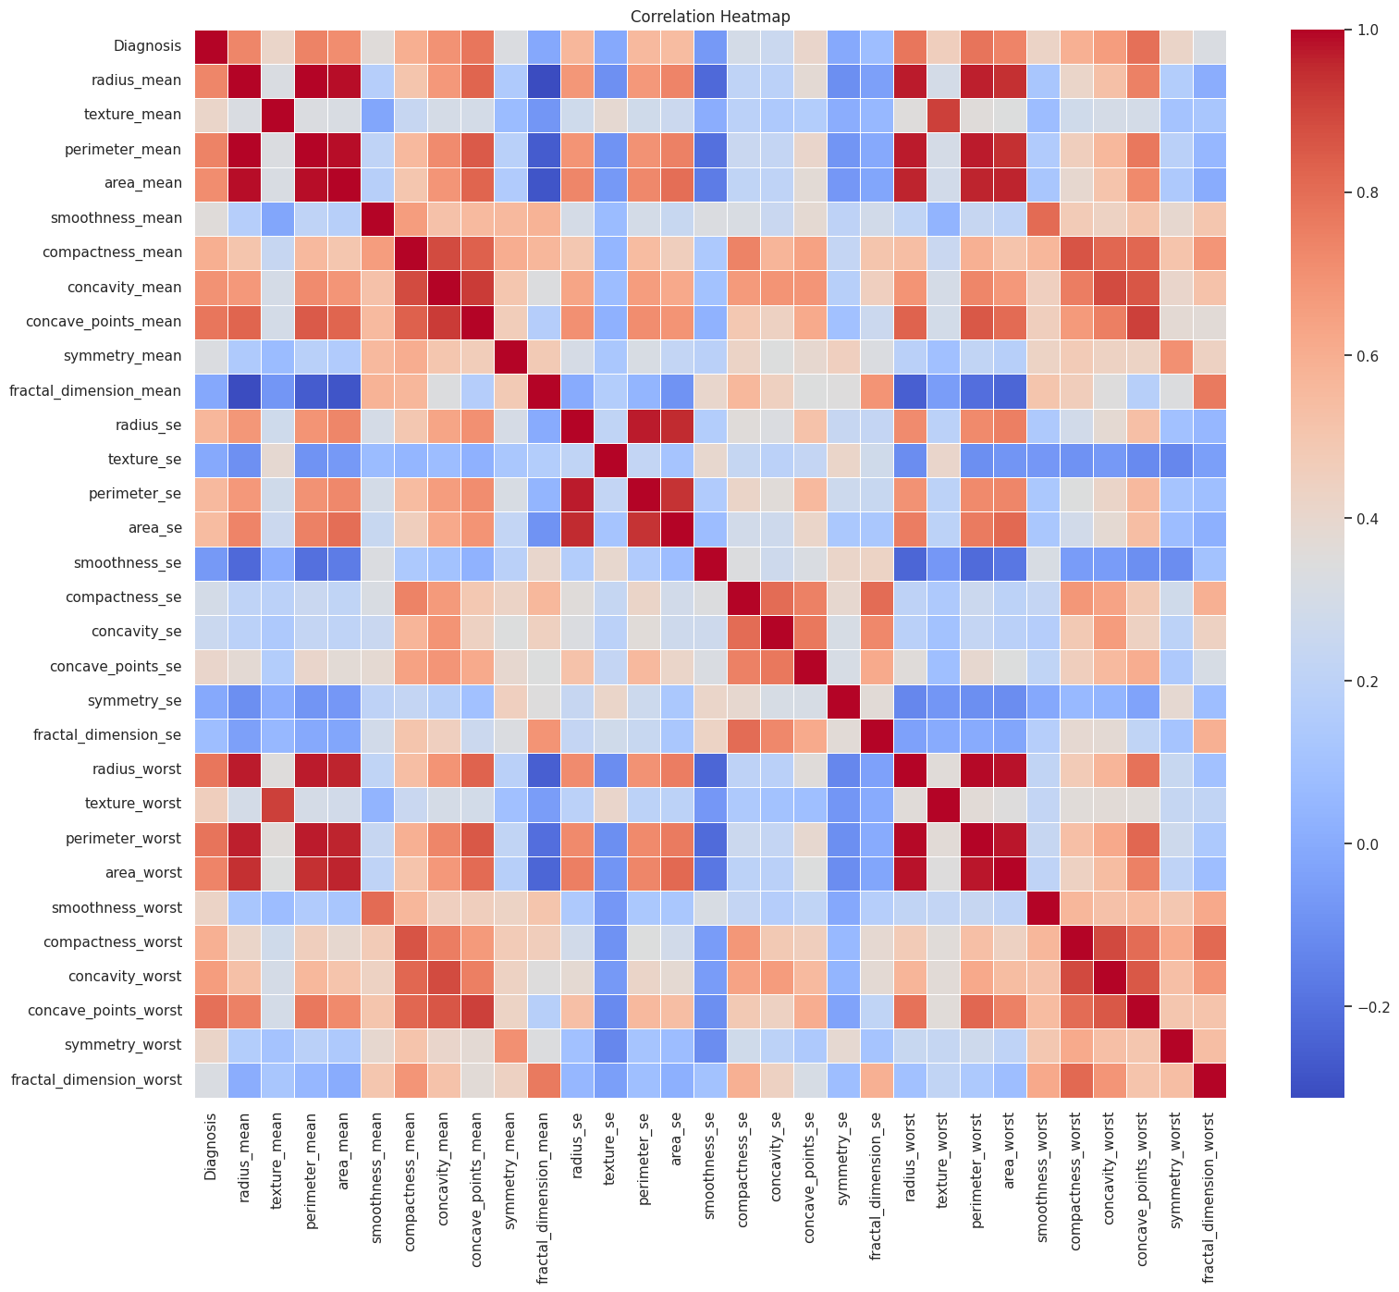
Data Preparation & Feature Engineering
[Figure 3: Correlation Heatmap]

Slide 7
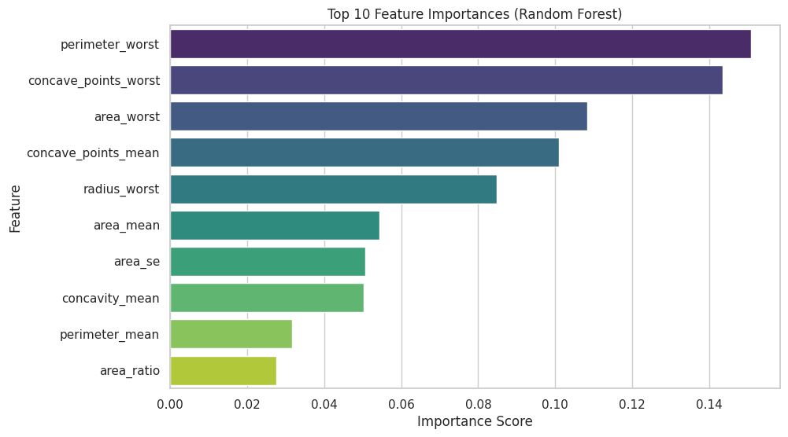
Data Preparation & Feature Engineering
[Figure 5: Top 10 Feature Importances]

Slide 8
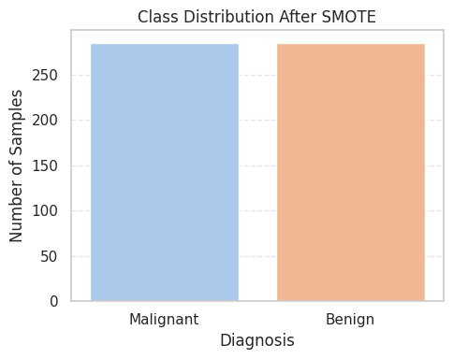
Model Development
Our pipeline followed this path: after splitting, we balanced the training set, then trained three classifiers — Decision Tree, KNN, and SVM — on the top 10 features.
Data
Train/Test Split
SMOTE
Model Training
Evaluation
[Figure 6: Model Training Workflow]

Slide 9
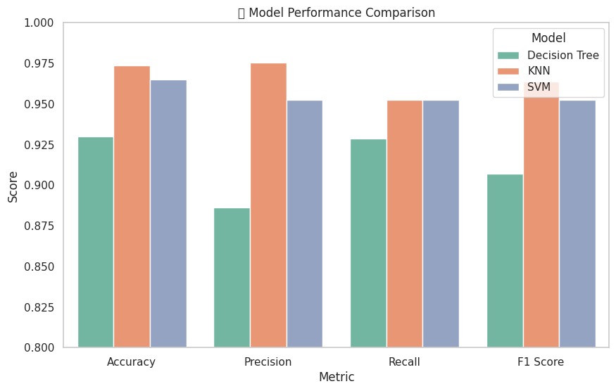
Model Evaluation - Model Performance Comparison
KNN emerged as the most consistent performer with a 97% accuracy, outperforming SVM and Decision Tree in both recall and F1 score

Slide 10
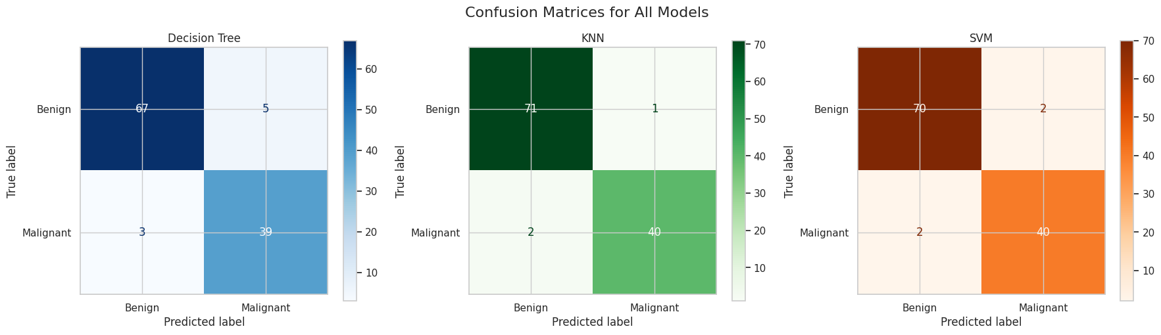
Model Evaluation - Confusion Matrices
KNN and SVM made fewer critical errors — especially false negatives — compared to Decision Tree. This is crucial in a medical context.

Slide 11
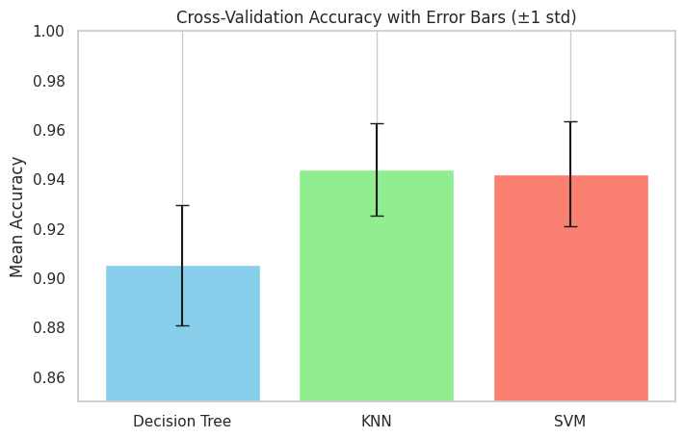
Model Evaluation - Cross-Validation Stability
To ensure reliability, we performed 5-fold cross-validation. KNN not only performed well but also had the lowest variation across folds.

Slide 12
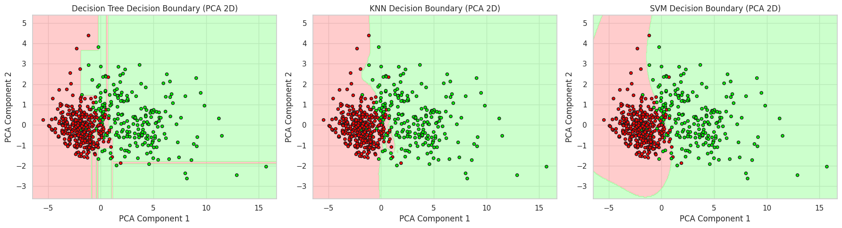
Model Evaluation - Decision Boundaries
This plot shows how each model separates benign and malignant tumors in a reduced 2D space. Notice how KNN and SVM form clean, generalizable boundaries.

Slide 13
Summary & Takeaways
KNN performed best with 97% accuracy and balanced recall
SMOTE was crucial to reduce bias toward benign
Visual interpretation helped validate model reliability

Slide 14

Q&A

